Slide 1
Secure Data Hiding in Images Using Steganography
CAPSTONE PROJECT
Presented By: Harsha Bangera
Student Name : Harsha Bangera
College Name : Bhavan’s College
Department: Computer Science

Slide 2
OUTLINE
Problem Statement
Technology used
Wow factor
End users
Result
Conclusion
Git-hub Link
Future scope

Slide 3
Problem Statement
Data security is a major concern in the digital world.
Traditional encryption methods are susceptible to brute force attacks.
Steganography helps hide encrypted data inside images, making it harder to detect.
This project integrates encryption with steganography for enhanced security.

Slide 4
Technology used
Programming Language: Python
GUI: Tkinter
Image Processing: PIL (Pillow)
Steganography: Stepic
Encryption: Cryptography (Fernet)
File Handling: PyPDF2, python-docx

Slide 5
Wow factors
Ability to hide text from TXT, PDF, and DOCX files into images
Converts a simple password into a highly secure encryption key using SHA-256 hashing and Base64 encoding, ensuring robust protection against unauthorized access."
Difficult to detect or extract hidden data without the correct password

Slide 6
End users
Cybersecurity professionals
Researchers who handle sensitive data
People who concerned with privacy & data protection

Slide 7
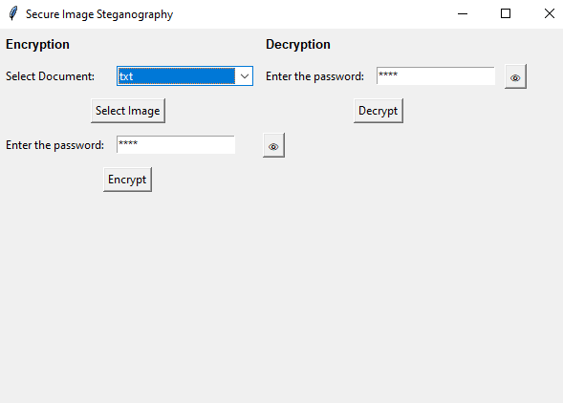
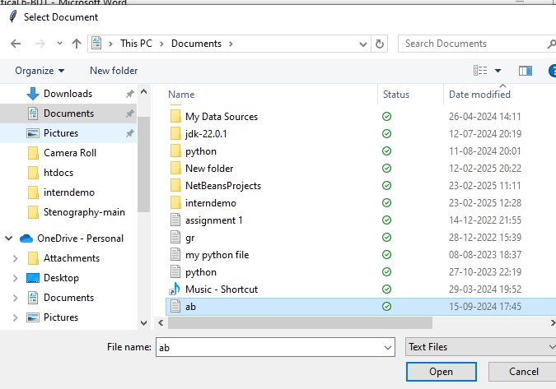
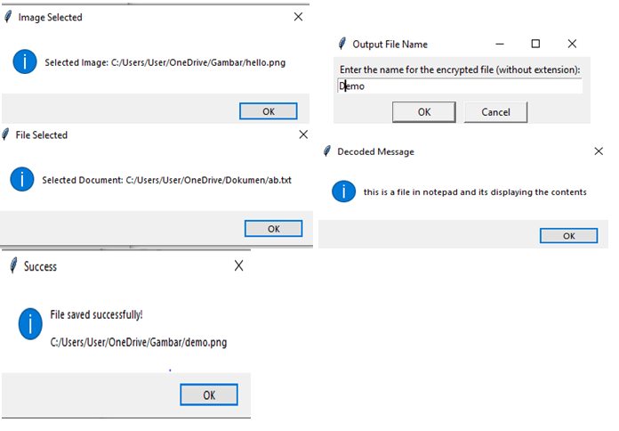
Results

Slide 8
Conclusion
This project provides a robust method for securing text data through image-based encryption.
Combining steganography with encryption adds an extra layer of protection against unauthorized access.
The user-friendly interface ensures ease of use for various security applications.

Slide 9
GitHub Link
https://github.com/hharshaa-hub/project_01.git

Slide 10
Future scope(optional)
Implementing stronger encryption algorithms

Slide 11
THANK YOU

